Slide 1
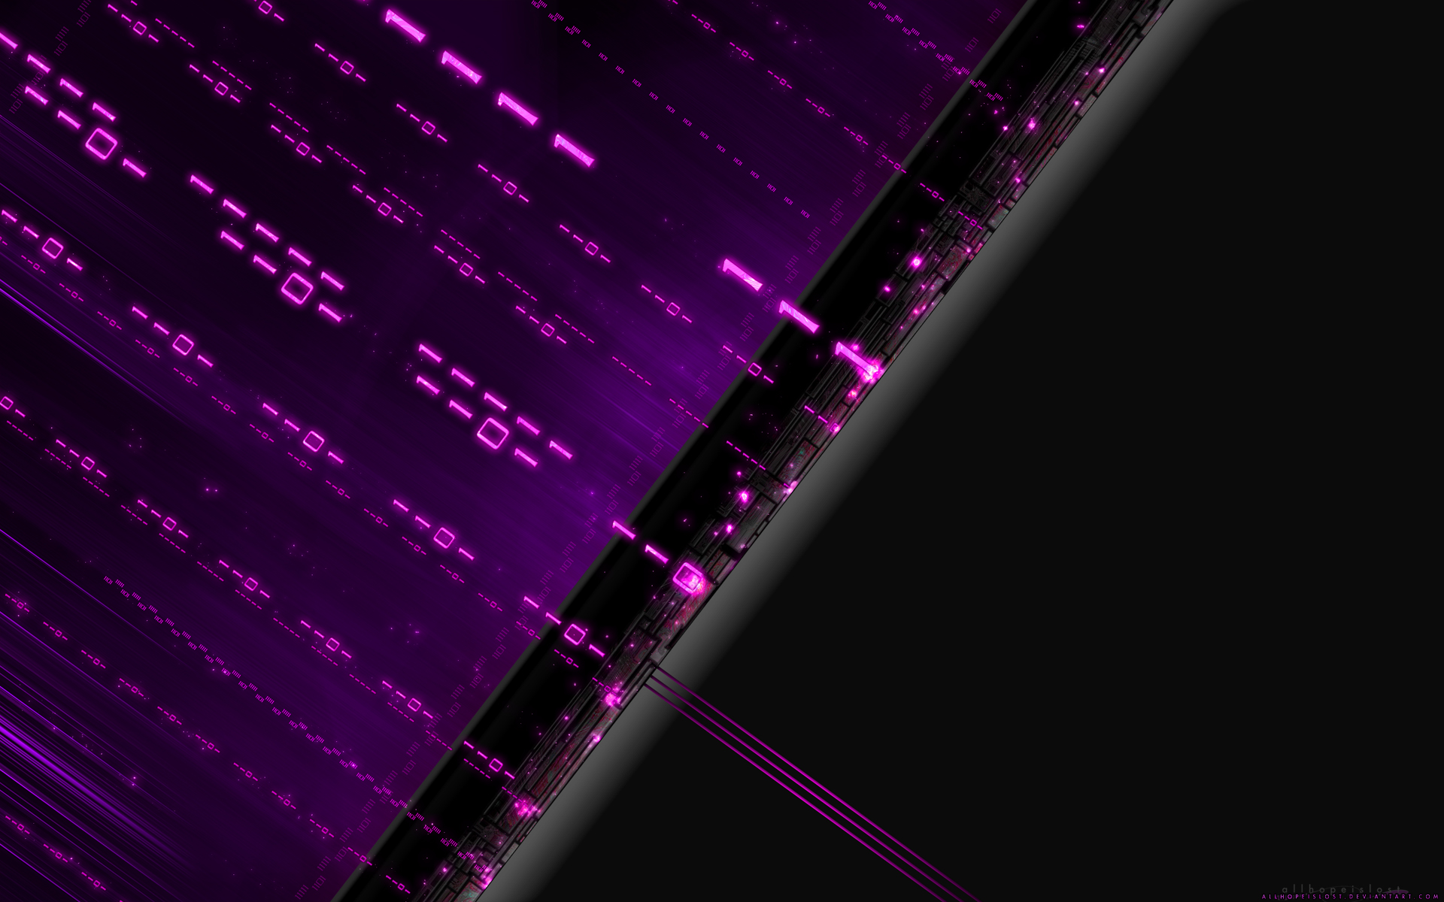

Anonymous
By Alex Cannell

Slide 2
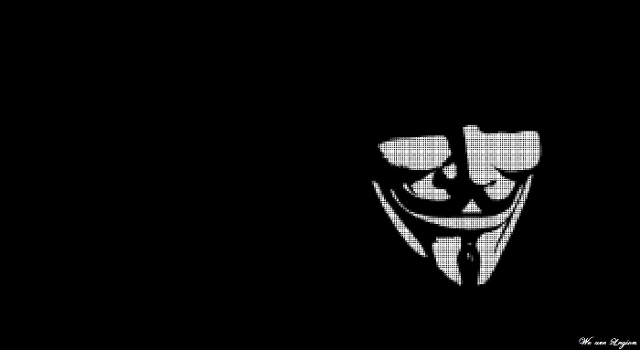
We Are Legion, We Are Anonymous, We Don’t Forget, We Don’t Forgive…
Anonymous
Anonymous (used as a mass noun) is a group, whose members are geographically spread around the world but connected through the Internet, initiating active civil disobedience, while attempting to maintain anonymity. It is considered to be a blanket term for members of certain Internet subcultures, a way to refer to the actions of people in an environment where their actual identities are not known.
In its early form, the concept has been adopted by a decentralized online community acting anonymously in a coordinated manner, usually toward a loosely self-agreed goal, and primarily focused on entertainment. Beginning with 2008, the Anonymous collective has become increasingly associated with collaborative, international hacktivism, undertaking protests and other actions, often with the goal of promoting internet freedom and freedom of speech. Actions credited to “Anonymous” are undertaken by unidentified individuals who apply the Anonymous label to themselves as attribution.

Slide 3
Who are the Anonymous Hackers?
This question is hard to answer, it’s no coincidence that the word anonymous is in their name. Even tough we don’t know for sure if Anonymous is a group or an individual, we assume it’s a group. You could say that Anonymous is an international hacking group. The main goal of the Anonymous hackers is to protect the freedom of expressing your own opinion and protection of free usage of the internet.
-No one knows who they are

Slide 4
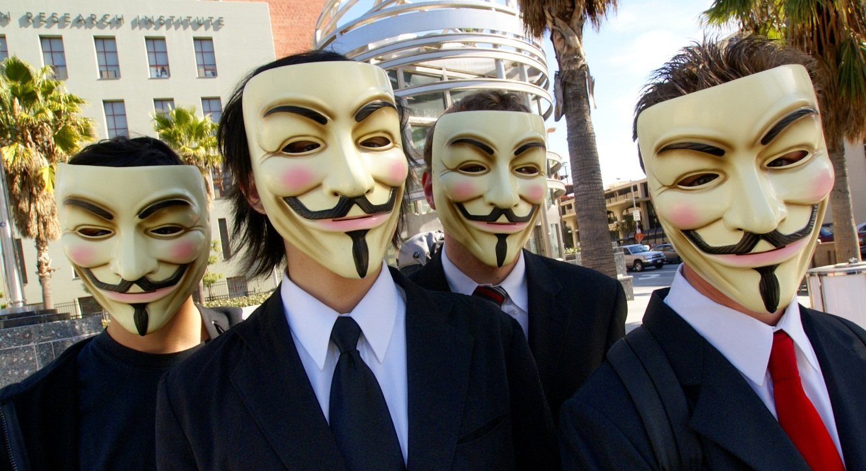
April 1st 2008 in los Angeles wearing Guy Fawkes mask’s

Slide 5
Major Event’s
WikiLeaks-
The Pirate Bay-
April 2009, Anonymous launched a DDoS Attack against the International Federation of the Phonographic Industry(IFPI), the organisation responsible for safeguarding rights.
Megaupload-
Jan. 2012, where the US Department of justice shut down the Megaupload because it provided file sharing services. Anonymous protested, “the single largest internet attack in the internets history...couldn’t have come at a worse time in terms of the governments standpoint.”
SOPA/PIPA-
Oct. 2011, Anonymous launched an DDoS Attack against the Department of Justice website, the site was shut down for 70 minutes, which also brought down several websites that belongs to the Department of Justice. In Jan. 2012, Anonymous preformed a DDoS attack with over 5,635 people against anyone or any organization that supported the bill.
Government Websites-
April 2012, Anonymous took responsibility for take down government websites in the UK because extradition and surveillance polices.
LGBT Issues-
August 2012, Anonymous hacked into Ugandan government websites in protest of pending homophobic bills.
Other Attacks
Oct. 2011, Anonymous threatened the a Mexican Drug Cartel after one member was kidnapped.
May 2012, Anonymous took down GM website.
Sept. 2012, Anonymous took down GoDaddy’s Domain Name Server, affecting small businesses websites around the globe.

Slide 6
Do you agree with the Anonymous?

Slide 7
http://www.anonymoushackers.net/
http://www.theregister.co.uk/2009/04/20/ddos_hacktivism_pirate_bay/
https://whyweprotest.net/anonymous-scientology/anonymous/
http://en.wikipedia.org/wiki/Anonymous_%28group%29
http://rt.com/usa/news/anonymous-barrettbrown-sopa-megaupload-241/
http://en.wikipedia.org/wiki/Low_Orbit_Ion_Cannon
http://www.guardian.co.uk/technology/video/2011/oct/31/anonymous-hackers-mexican-drug-cartel
http://www.guardian.co.uk/environment/2012/may/28/gm-crop-trial-website-cyber-attack

